Slide 1

WAY TO ENTERPRISE
React JS
VTI ACADEMY
Author: duy.nguyenngoc1@vti.com.vn
March 2020

Slide 2
Agenda
Module
Assignments
Copyright © VTI Academy All Rights Reserved

Slide 3
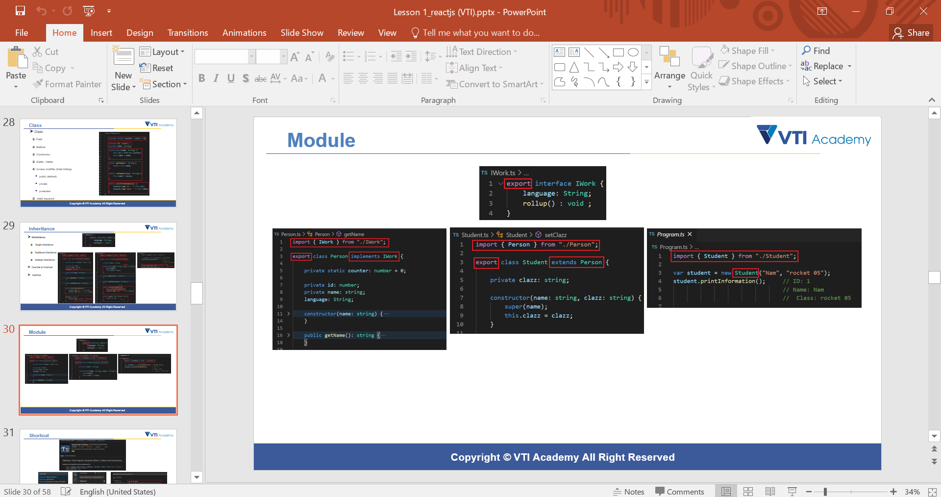
Module
A module is a file
Components can be exported and imported in a module
Only export and import when different files

Slide 4
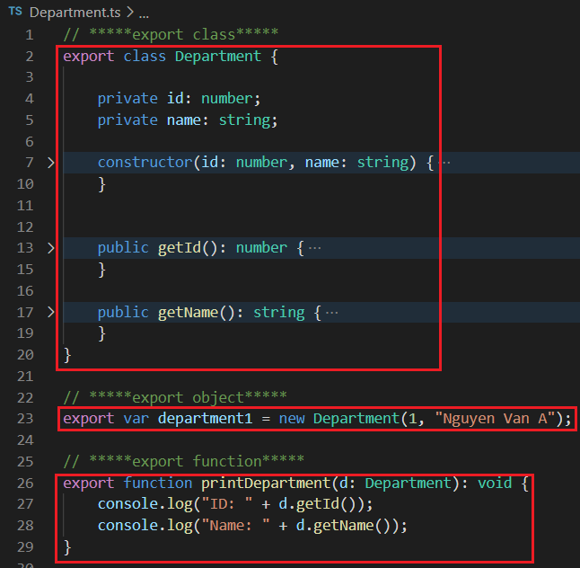
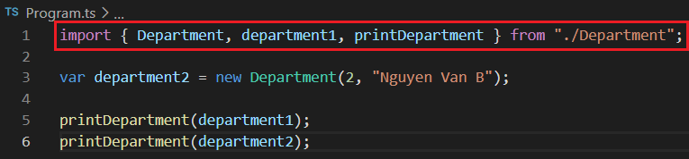
Exporting
Can export a function, class, object
import
Export when initialized

Slide 5
Exporting
2 types
Named export
Default Export

Slide 6
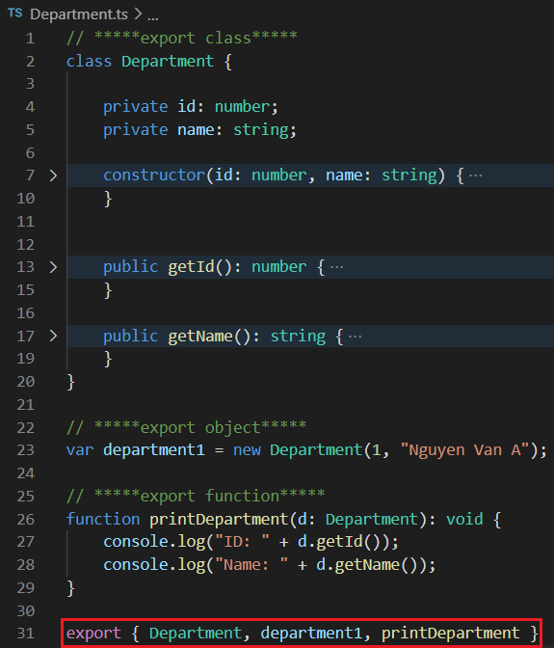
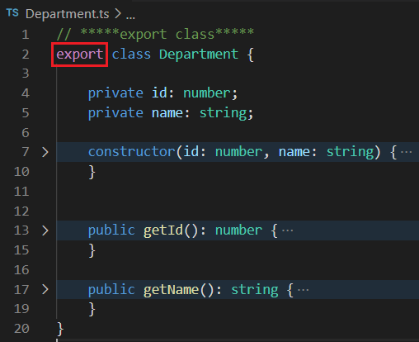
Named Exporting
Export when initialized
Export at the end of the module file
Can use multiple exports in one file

Slide 7
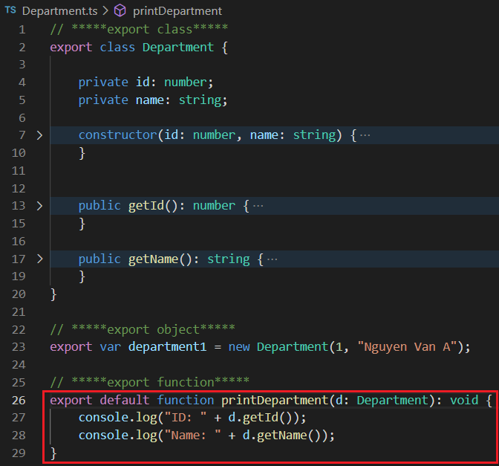
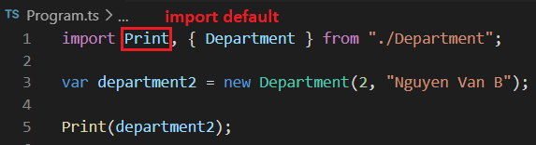
Default Export
A file can have 0 or 1 default export
Default export can be class, object, or function
import default
export default
The import name is independent of the export name

Slide 8
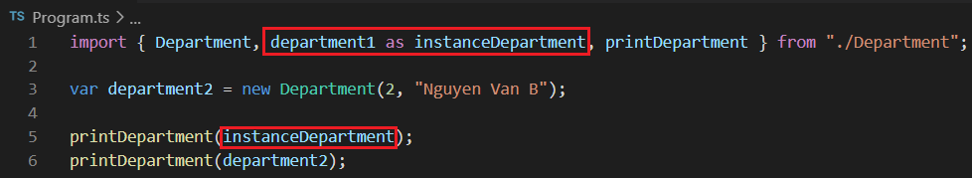
Importing
Keyword as
Rename imported component

Slide 9
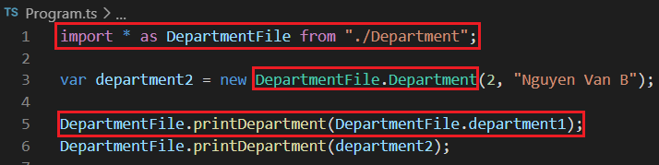
Importing
Import *
Group all the exported components in a module into a single name

Slide 10
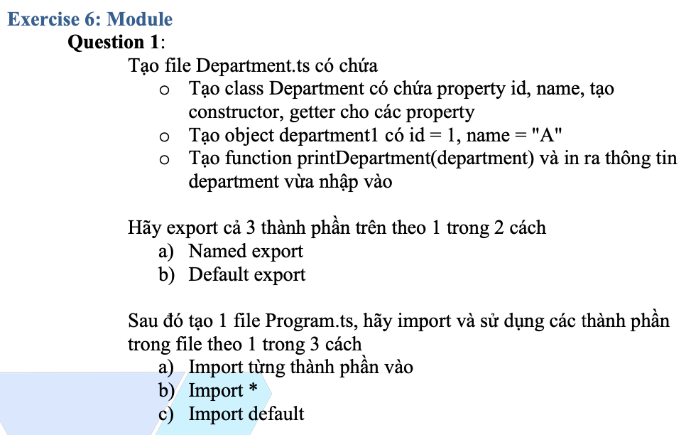
Testing System Assignments
Exercise 6: Module

Slide 11
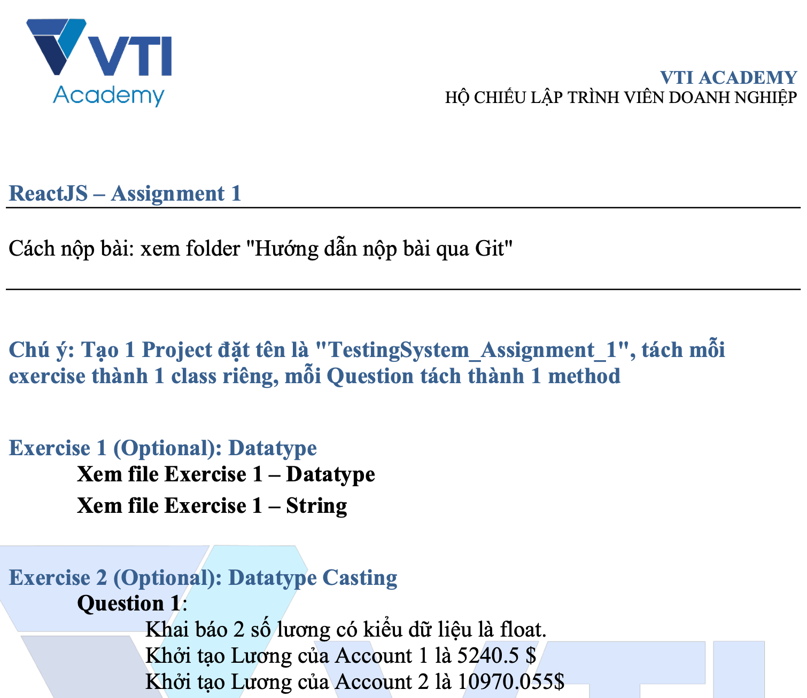
Testing System Assignments

Slide 12
Reference
https://www.javatpoint.com/typescript-tutorial
https://www.tutorialspoint.com/typescript/index.htm

Slide 13
Q & A
Copyright © VTI Academy All Rights Reserved

